Slide 1
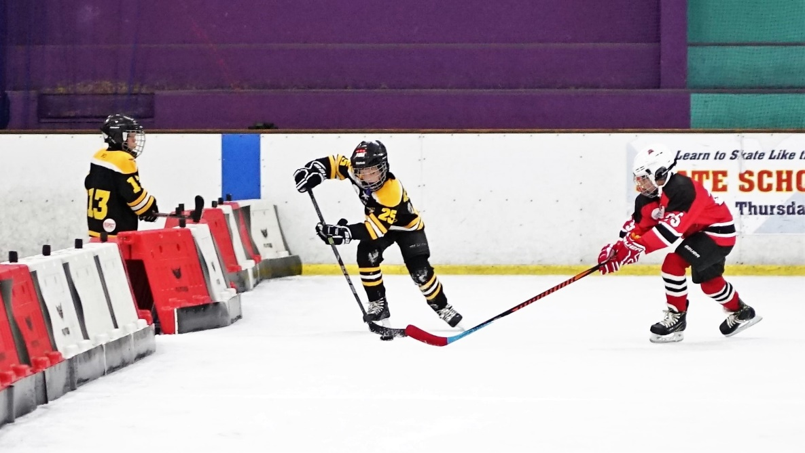
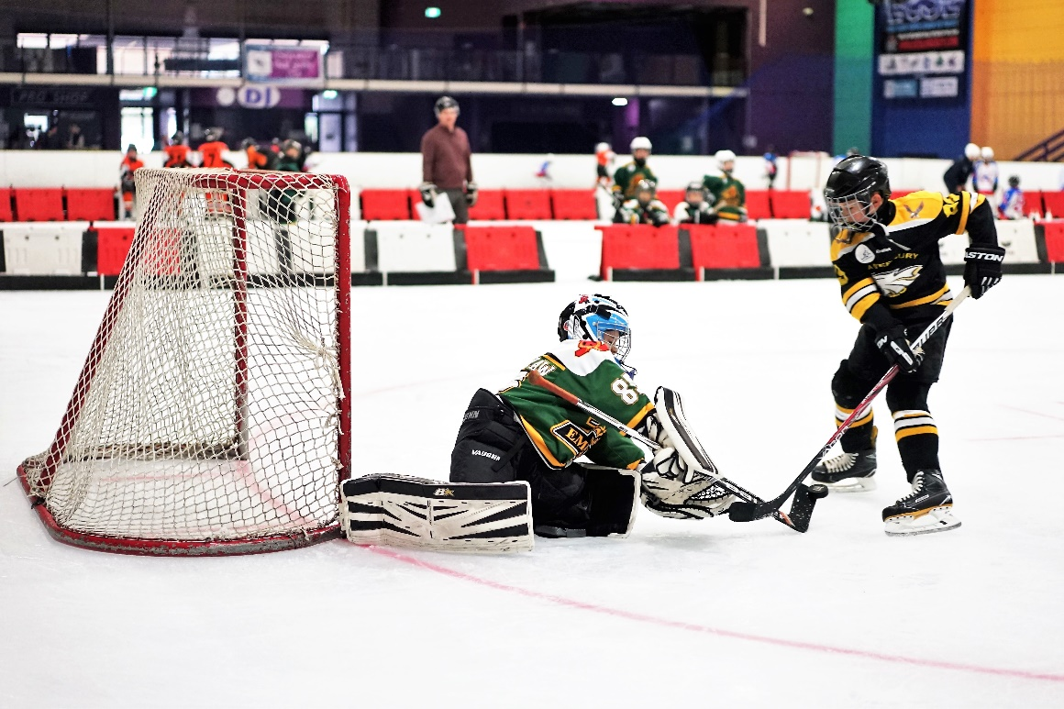
U8 Mites & U10 Atoms 3 on 3 2018
IHNSW 3 on 3 Winter Comp
U8 - Mites
U10 - Atoms

Slide 2
U8 Mites & U10 Atoms 3 on 3 2018
Objectives of 3 on 3
Grow the sport and increase participation.
Skills development.
Provide a program & environment suitable for young players.
Increased opportunities for players to touch and handle the puck.
Increase opportunities for the goalies with more shots on & faster play.
Improve the utilisation of ice time.
Fostering a lifelong love of ice hockey.
Learn fundamentals of hockey without the pressure of going for the win.
This is NOT a competitive division.
Introduce Peewees to officiating roles.
U8 Mites & U10 Atoms is all about having FUN!!!

Slide 3
U8 Mites & U10 Atoms 3 on 3 2018
Benefits of 3 on 3
Develops long term good ice hockey habits.
More opportunities for goals
More space for passing, encourages positioning to be open for passes
Room to skate with the puck, encourages heads up skating with the puck
Encourages sprinting on and off the bench
Encourages fast game play with 90 sec time limit per line.
There is no crowding around the puck.
Kids of all skill levels have the opportunity to be involved in the game.
Increased opportunities for players to touch and handle the puck.
Increase opportunities for the goalies with more shots on & faster play.
Learn fundamentals of hockey without the pressure of going for the win.
Improve the utilisation of ice time.
Fostering a lifelong love of ice hockey.
Kids develop fast decision making.
Studies show that kids receive 5 times more passes and take 6 times more shots on goal when comparing cross ice 3 on 3 to full ice games at the same age playing 5 on 5.

Slide 4
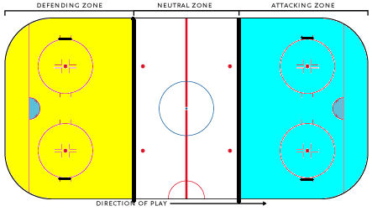
U8 Mites & U10 Atoms 3 on 3 2018
Rink setup for 3 on 3
Equipment:
4 goal nets are required
Minimum of 4 Blue pucks (Mites) Black pucks for Atoms.
Ropes or barriers
The rink will be separated into 3 playing areas.
Zone 1 and Zone 2 are used for 3 on 3 games.
Zone 3 is used players waiting for line changes for the games.
Goals are placed on the edge of the circles as shown below.
Ropes or barriers are placed across the blue lines separating the zones.
Zone 1
Zone 3
Zone 2
Rink entry

Slide 5
U8 Mites & U10 Atoms 3 on 3 2018
Game structure
The games are played as cross ice 3 on 3 in the defensive zones as per the previous slide.
The Mites games will be played with the blue pucks (lighter pucks) as this will give the players confidence and will develop their basic skills. Atoms will use black pucks.
The minimum number of players per team will be 7 players. Equal ice time will be given ALL players. The maximum team size is 10 players.
A whistle will sound 2 mins before the start of the first game. Teams coaches should gather their team at centre ice on this whistle and ready their team to start playing.
The IHNSW referees will drop the puck in both zones at the same time on the next whistle. It is a round robin structure, ie there will be 3 games per session.
Each game will run for 16 min (90 secs X 11). After 90 seconds a whistle will sound for player line changes.
The clock buzzer will sound at the end of each game (16 mins).
There will be a 2 min break between games so teams can swap ends as per the draw.
The score will not be recorded.
There will be 1 Cross Ice Zone Official in each zone with an optional Cross Ice Head Official for mentoring in centre ice.

Slide 6
U8 Mites & U10 Atoms 3 on 3 2018
Rules for 3 on 3
No scores or stats to be kept for the games or kids in these age divisions. The focus is on development & fun.
The Zone Officials will drop the puck at the start of each game.
During line changes the puck will be left where it lies.
A spare puck will be available in case the game puck lands outside of the boards. The Zone Official is to throw the spare puck to an empty corner to restart play.
If the goalie stops the puck, the attacking team must skate to ½ way before going for the puck. The goalie gives the puck to a team mate to continue play.
Minimum team size is 7 (2 lines of 3 players + Goalie) maximum is 10 (3 lines of 3 players + Goalie ).
To play in the next age divisions the IHNSW playup form is to be completed by the parent and coaches.
Players must play their age division prior to playing up into another age division. This is a standard rule for all grades. In this transition year (2018) there will be some leniency on this rule.

Slide 7
U8 Mites & U10 Atoms 3 on 3 2018
Special rules U8 and U10
U8 special rules:
There are no stoppages for U8.
If a team scores a goal the attacking team is to skate back ½ way. The official will go pick up the puck from the net and throw the puck to an empty corner.
U8 Penalties – The referees will not call penalties, however repeat offenders will be benched by the referee for their next shift. Coaches are to educate players. The benched player can be substituted so the team is not playing short.
Mites will use the lighter Blue pucks.
U10 special rules:
When a goal is scored the Referee takes the puck back to centre ice for a face-off without delay. The referee will drop the puck even if teams are not lined up.
U10 Penalties will result in a penalty shot with play-on after the shot. All skaters not taking the shot will start skating from the opposite goal net, the shooter will start from the center. When the whistle blows all players can start skating.
During line changes, the puck must be left where it is, if played by U10 Atoms it will result in a penalty shot.

Slide 8
U8 Mites & U10 Atoms 3 on 3 2018
Play ups and downs
Squirt play-downs
There are no play downs from Squirts to Atoms/Mites. Atoms and Mites are not a dumping ground for beginner squirts. Kids should be encouraged to play their age division. Only on special consideration will beginner squirts be considered to join Atoms/Mites games for a short period of time to gain skills and confidence. These players must also play their Squirts games where there are no clashes to accelerate their development & confidence.
Applications should be made in writing to eo@ihnsw.com.au. A 3rd party coach will assess the application. The application can be withdrawn at any time, when the 3rd party coach advises the player is should focus just on Squirts.
Mites Play-ups to Atoms
Parents who wish to have their Mites play Atoms must complete a play up form and submit to the Mites team coach. It is at the Mites & Atoms team coach’s discretion who they agree can play up and when. This may change throughout the course of the season. It is a privilege to play up, not a right. There are no permanent play ups. Due to Mites numbers, if Mites are scheduled to play they must play Mites not Atoms.
Filling teams for game day
IHNSW and Clubs agree that kids, where possible, should play in the correct age division. If Atoms numbers are short for game day, we will request other Atoms kids to fill the void. In line with the rule book, All kids are to be played equally. The aim is to build up all the kids, not just a few stars.

Slide 9
U8 Mites & U10 Atoms 3 on 3 2018
2018 (only) Play up rule
Temporary rules for Mites play up to Atoms 2018
Mites are scheduled to play 10 times in the 2018 Winter season.
There are no clashes between Mites and Atoms games.
Players must have a valid play up form completed by the Atoms and Mites coaches.
Mites are expected to play Mites as scheduled
Mites must attend at least 5 Mites sessions before week 20 otherwise they will not be eligible to play up into Atoms or Squirts for the rest of the season, including the round robin. No permanent play ups into Atoms or Squirts
Temporary rules for Atoms play up to Squirts 2018
Each Atoms team will play either 14 or 15 games in the 2018 Winter season.
Players must upgrade to Squirt registration.
Players must have a valid play up form completed by the Atoms and Squirts coaches.
Atoms must play at least 10 games in the Atoms grade before week 22 otherwise they will not be eligible to play up into Squirts for the rest of the season, including the round robin.
The Atoms team must consist of a minimum of 7 players before excess Atoms can play up to squirts were these games clash.
No permanent play ups into Squirts.

Slide 10
U8 Mites & U10 Atoms 3 on 3 2018
Refereeing for 3 on 3 (1/2)
See game structure & rules slide. Optional Head Cross Ice Official in centre ice controlling the session with a Zone Official in each Defensive zone controlling the games.
The Officials in Zone 1 & 2 will typically be new to officiating. The Head Official is encouraged and help the new referees with penalties, running of the games and talking to the coaches & parents.
Zone Officials are encouraged to talk to the players during the game to help them learn the rules of ice hockey.
For U8 Mites the Officials will escort repeat penalty offenders to the bench to sit out the rest of their shift & the next shift. Officials to advice the coach of why the player is being benched. The coach can substitute the player so they do not play short. The coach is to educate the player on rules and fair play.
The Goalie can be 1 child dressed as a player or in goalie gear standing in goals the entire game.
For line changes, the puck must be left where it is, if played by U10 Atoms it will result in a penalty shot.
If the goalie freezes the puck, the other team must skate back to ½ way then they can go for the puck.
Major penalties, assessed by the Officials as a serious infractions, may see a player or coach removed from the game or for the remainder of session.

Slide 11
U8 Mites & U10 Atoms 3 on 3 2018
Refereeing for 3 on 3 (2/2)
Anyone not wearing a helmet must be escorted off the ice. Repeat offenders will be removed from playing the rest of the session.
Cross Ice officials no not need to complete the linesman course to be eligible. Cross Ice Zone Officials must be 11 or older.
Zone Officials to wear either a plain black jersey or an officials striped black & white jersey.
Officials must bring your own whistle.
IHNSW are encouraging Peewee players to try officiating ice hockey in the hope that they will pursue it further as they get older. IHNSW want to make officiating Mites and Atoms as comfortable as possible for new Officials. As such any code of conduct issues with parents or coaches should be raised with the Head Cross Ice Official on the day or the IHNSW MPIO Miranda Ransome on miranda@swts.com.au within 48 hours of the incident.

Slide 12
U8 Mites & U10 Atoms 3 on 3 2018
Coaching for 3 on 3
Coaches can make a huge difference to how kids view ice hockey and retention rate. Let’s keep it fun and enjoyable for all participants.
Coaches are to have a current IHNSW coaching certificate, working with children certificate & abide by the IHNSW & club code of conducts.
Coaches prepare the rink for the Cross-ice games, ie nets, goals and barriers 10 mins prior to the games and put equipment away after the session has completed.
Team coaches must wear a helmet & skates when on the ice.
Team lines waiting there turn in centre ice must be under the control of the team coach.
Coaches must play all kids equally. $100 fine applies for non-compliance as per the IHNSW handbook.
It is strongly encouraged to rotate ALL players through the Goalie position for U8 Mites and U10 Atoms.
There are no penalties for U8 Mites, however if the player is continuously misbehaving it will be the referee and the coaches job to bench the player for their next shift or remainder of the game. Coaches are to educate their team on actions that would constitute as a penalty in older grades and teach fair play.
Coaches are to provide lots of praise and encouragement to the kids so that everyone feels valued and looks forward to playing again.
This is NOT a competitive division. The main rule of U8 Mites & U10 Atoms is have FUN!!!

Slide 13
U8 Mites & U10 Atoms 3 on 3 2018
Managing for 3 on 3 (1/2)
Team managers are not to go on the ice.
No scores or stats to be kept for these age divisions. The focus is on development & fun.
The optimum team size is 2 lines of 3 players plus 1 Goalie. This is the most cost effective team size and provides the most ice time for all kids. The minimum team size on game days is 7, maximum is 10.
Bibs will be provided to managers for combined teams.
Note: the more kids per team, the less game time they will have & the more the team as a whole will pay to the rink.
It is the team managers responsibility to have to correct amount of kids for game days and a completed team sheet to hand to the hosting manager.
Goalie can be 1 child dressed as a player or in goalie gear standing in goals the entire game. Clubs to ensure a small goalie kit is available for this.
Hosting team managers must have access to goals, blue puck (Mites) black pucks (Atoms) and ropes on the day.

Slide 14
U8 Mites & U10 Atoms 3 on 3 2018
Managing for 3 on 3 (2/2)
Hosting team managers are to collect the team sheets. Officials to be listed on one of the team sheets. The hosting manager to email all the team sheets to eo@ihnsw.com.au by 5pm Sunday. This is mandatory.
The hosting team manager is to collect the rink payment from each team and pay the rink management as per the table in finances slide.
The hosting managers are to organise someone to sounds the “2 min to start” and 90 sec line change whistles & someone to run the timing of the games of 16 mins on the rink clock.
Games MUST start on time and time managed to ensure 3 games are played within the hour.
Team managers are to ensure the changerooms are clean after the session.
Parents are to supply kids with labelled drink bottles that can be used without unfastening helmets.

Slide 15
U8 Mites & U10 Atoms 3 on 3 2018
Game days
Teams arrive at the rink at least 30 mins before the games.
Coaches prepare the rink for the Cross-ice games, ie nets, goals and barriers 10 mins prior to the games.
Hosting team manager is to collect all the team sheets. Officials will also need to be listed. The hosting manager to email the attendance sheet to eo@ihnsw.com.au by 5pm Sunday.
The hosting team manager is to collect the rink payment from each team manager and pay the rink management. See finance slide.
The hosting manager to organise someone to sounds a “2 min to start” whistle & run the timing of the games. Games MUST start on time and time managed to ensure 3 games are played within the hour.
Team managers must know what zone their team is playing in for each game.
After the games the coaches will put away the nets (if required) goals and barriers.
Change rooms are not allocated per team. Please use what is available.
Team managers to ensure their team has a MIMIMUM of 7 players and a MAXIMUM of 10 players attend on game day.
All team managers & coaches are to work together to ensure minimum team sizes of 7 are met. This may mean sharing of players. Bibs will be provided to team managers.

Slide 16
U8 Mites & U10 Atoms 3 on 3 2018
Example Game days - timing
Example timing for 3 on 3 cross ice games with start time 9:00am
8:50 - coaches prepare the rink
8:58 - 2 min to start whistle, coaches ready the teams in Zone 3.
9:00 - start whistle – puck drops in both zones.
9:01:30 - 90 sec line change whistle
9:03 - 90 sec line change whistle etc
9:16 - clock buzzer game end, change zones if required.
9:18 - start whistle – puck drops in both zones.
9:34 - clock buzzer game end, change ends if required.
9:36 - start whistle – puck drops in both zones.
10:00 - clock buzzer session end.
10:00 – coaches put away goals, ropes & nets if required.
Note there is 6 mins time buffer to play with if running late. This time can be used to extend the last game till 10:00.

Slide 17
U8 Mites & U10 Atoms 3 on 3 2018
Team managers - Financials
The team managers are responsible for collecting team fees.
The team manager is responsible for the funds collected from their team. It is advised that team managers collect $25 per player each session to cover rink fees.
Hosting team managers will collect rink fees for the session from the other club team managers and pay rink management prior to the session starting and collect a receipt.
Left over funds go to each clubs kitty held by each team manager. The team manager is to check with their club execs on how the kitty can be used at the end of the season, ie coaches gift, given back to parents etc. Each club is different.
Team managers to ensure their team has a MIMIMUM of 7 players and a MAXIMUM of 10 players attend on game day.
Team managers must pay the minimum rinks fee if they have 6 or less players. Otherwise payment is per player as seen in the table above. Managers to work together to even out teams where possible.

Slide 18
U8 Mites & U10 Atoms 3 on 3 2018
More information
Mites U9 3 on 3 cross ice was trialled in 2014 over summer with great success. It continued to be successful for Summer 2015 with some minor tweaks. In 2016 U9 Mites was introduced into the IHNSW Winter competition.
In 2018 the age divisions have been adjusted to be in line with IIHF. U8 Mites and U10 Atoms cross ice are introduced.
2018 U8 Mites and U10 Atoms will be setup to run like all other junior grades, ie each club enters team/s, assigns a coach and manager and IHNSW assigned referees and ice time. Like every other grade, the teams are to follow the format set by IHNSW.
3 on 3 cross ice was determined to have the best outcomes for developing confident and skilled ice hockey players for the future.
The 3 on 3 cross ice format is a long term strategy to develop the Australian ice hockey players of the future. The format can be easily followed and replicated year on year, no matter how many kids register.
Clubs can enter as many U8 Mites and U10 Atoms teams as they wish into the competition. Excess kids can either be rotated in & out of the club team or a composite team can be made. To keep the sport growing, IHNSW prefers to make composite teams to ensure all players have equal ice time across the season in their correct age division.

Slide 19
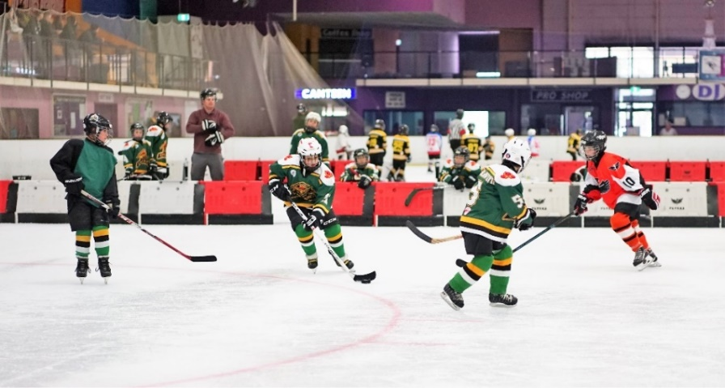
U8 Mites & U10 Atoms 3 on 3 2018
More information Cont’
On rink fees: In general , rinks are privately owned family businesses and as such wish to make money to support their families. The rink owners advise IHNSW the set rink fees at the start of the hockey season. IHNSW does not negotiate ice rink fees.
On ice allocations: At the start of the season each rink owner provides a list of ice time allocated to IHNSW for games. IHNSW then must fit all grades into the ice made available by the rinks. Where possible U8 & U10 games are provided the best ice time available to encourage participation.
Each Mites & Atoms aged player will need to register with their club through esportsdesk to play.
Clubs to ensure coaches have a current IHNSW coaching certificate and team managers understand the rink fee structure.

Slide 20
U8 Mites & U10 Atoms 3 on 3 2018
Issues
For parents:
Any issues, concerns or queries are to be directed to your team manager.
Most queries from parents are the same, so the manager should be able to address these quickly.
If you are not receiving the support you require, your next point of call are your club execs.
For managers:
Any team issues, concerns or queries are to be directed to your club execs. The club execs have a wealth of knowledge and experience in managing teams and know the intricate details of ice hockey.
Any Mites/Atoms admin issues, concerns or queries are to be directed to Stacey@scrimshawengineering.com with your club execs cc’d on the email. Manager also have my phone number. If you have concerns on game day, please call for quick clarification.
For coaches:
Any cross ice 3 on 3 game format issues, concerns or queries should be directed to Tomas Manco.
Communications to IHNSW are to be directed through your club execs.
Note: To ensure consistency for the current season, any suggestions to change the format of 3 on 3 cross ice games will be assessed by IHNSW after the completion of the season. Suggestions should be directed to your club execs to bring to IHNSW.

Slide 21
U8 Mites & U10 Atoms 3 on 3 2018
Decisions
Request for set cost per team for Mites ice time.
In 2017 team sizes were not controlled and session fees of >$800 were experienced. Team managers requested IHNSW to have set fees for Mites ice times.
Result - This was rejected as it would likely drive up the cost for all other grades. Clubs and team managers are to control team sizes. Clubs can enter multiple teams or composite teams can be made in minimise players per team to 7-10.
Request for rink owner details.
Mites team managers requested contact details of rink owners to request set fees per team for Mites sessions.
Result – This was rejected. Parents, team managers and coaches should not approach rink owners to discuss rink fees. This is to be left to the club executives.
Request to change format from 3 on 3 to 4 on 4 or 5 on 5.
Mites managers and coaches requested a change in format for Mites 3 on 3 to accommodate the large number of players attending Mites session in 2017.
Result – This was rejected. 3 on 3 has been proven to show the greatest results. See benefits slide. Team managers, coaches and clubs to control team sizes to between 7 -10 and retain the 3 on 3 format. Additional teams can be added to the grade to keep team sizes manageable.

Slide 22
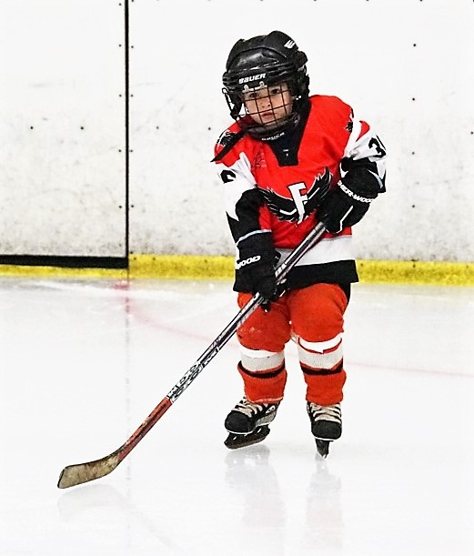
U8 Mites & U10 Atoms 3 on 3 2018
Volunteers
Ice Hockey in Australia runs on volunteers. It is a rewarding experience knowing that you are helping the your child, their team and the sport.
It is strongly encouraged for all parents to get involved in helping to manage, coach, time keep, support the team manager etc.
Ensure you have read and understand the code of conducts agreed to when registering with IHNSW and your club.
On behalf of IHNSW, thank you for volunteering your time and energy to making U8 Mites and U10 Atoms successful in 2018.
Thank you

